Slide 1
2.4 Simple I/O (Input and Output)
ITP3914 – Programming
Part 2 – Concepts of Data Types and Operations

Slide 2

Part 1 – Console Input and Output

Slide 3
Console Output
System.out.print("message to display");
Keeps the cursor at the end of the same line after displaying the message
System.out.println("message to display");
Jumps to the next line after displaying the message
c:\> java OutputDemo
You must work hard to get a pass in
ITP3914.
public class OutputDemo {
public static void main(String [] args) {
System.out.print ("You must work hard ");
System.out.println ("to get a pass in");
System.out.println ("ITP3914.");
}
}

Slide 4
Escape Characters
Escape characters (prefixed with a backslash \ can be used in an output string
to mean a special character to be printed.
Escape Sequence | Description
\n | Newline. Position the screen cursor to the beginning of the next line.
\t | Horizontal tab. Move the screen to the next tab stop.
\r | Carriage return. Position the cursor to the beginning of the current line. Any characters output after the carriage return overwrite the characters previously output on that line.
\\ | Backslash. Used to print a backslash character.
\" | Double quote. Used to display a double-quote character.

Slide 5
Escape Characters Example
Example 1
Test is
difficult!
System.out.print ("Test is \ndifficult! ");
Example 2
Exam is also difficult!
System.out.print ("Exam is \talso difficult! ");
Example 3
Homework is \you guess!
System.out.print ("Homework is \\you guess! ");
Example 4
But quizzes are "easy"!
System.out.print ("But quizzes are \"easy\"! ");
Example 5
I was always hea…
but no more la…..
System.out.print ("I was always hea…\rbut no more la..");

Slide 6
One More Example
public class EscapeTable {
public static void main(String [] args) {
System.out.println( "The following prints the escape characters:\n" );
System.out.println( "\\t\tTab character" );
System.out.println( "\\n\tNew line character" );
System.out.println( "\\\\\tBackslash character" );
System.out.println( "\\\"\tDouble quote character" );
}
}
You tell me what the output is!

Slide 7
Console Input
import java.util.*;
public class Score {
public static void main(String [] args)
{
Scanner kb = new Scanner(System.in);
int midterm, finalExam;
double average;
System.out.print("Midterm? ");
midterm = kb.nextInt();
System.out.print("Final? ");
finalExam = kb.nextInt();
average = (midterm + finalExam) / 2.0;
System.out.println ("Average = " + average);
}
}
Needed if you want to use “Scanner”.
This creates the kb object in connection to the keyboard.
This reads an integer from the keyboard.
Midterm? _
Midterm? 64
Midterm? 64
Final? _
Midterm? 64
Final? 71
Midterm? 64
Final? 71
Average = 67.5

Slide 8
Scanner Methods
Method | Description
nextByte() | reads an integer value of the byte type
nextShort() | reads an integer value of the short type
nextInt() | reads an integer value of the int type
nextLong() | reads an integer value of the long type
nextFloat() | reads a real value of the float type
nextDouble() | reads a real value of the double type
next() | reads a String that ends before a whitespace character
nextLine() | reads a line (a String ended by pressing the Enter key)

Slide 9
Reading a String
c:\> java ReadWord
Hello
Your input is: Hello
import java.util.*;
public class ReadWord {
public static void main(String [ ] args) {
Scanner kb = new Scanner(System.in);
String input = kb.next();
System.out.println("Your input is: " + input);
}
}
c:\> java ReadWord
Good Morning, Peter!
Your input is: Good
Only one single word is read!
kb.next() reads a String that ends before a whitespace character.
Whitespace characters include [Space] [Tab] and [Enter] keys.

Slide 10
Reading a Whole Line
c:\> java ReadWord
Good Morning, Peter!
Your input is: Good Morning, Peter!
import java.util.*;
public class ReadLine {
public static void main(String [ ] args) {
Scanner keyboard = new Scanner(System.in);
String input = keyboard.nextLine();
System.out.println("Your input is: " + input);
}
}

Slide 11
Part 2 – Graphical Input and Output

Slide 12
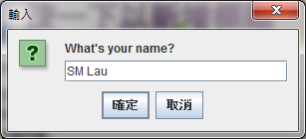
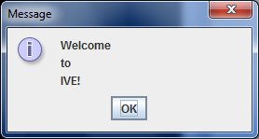
Dialog Box
Dialog boxes can be used to perform input and output.
Message dialog for output
Input dialog for input
Defined in the package javax.swing package
import javax.swing.*;
Or more specifically, only the class:
import javax.swing.JOptionPane;

Slide 13
Package and import
A package is a collection of related classes
Core packages:
java.*
Included with Java 2 Software Development Kit
Extension packages:
javax.*
New Java packages
Example
import javax.swing.JOptionPane;
Tells the compiler to load the class JOptionPane which is located in the extension package javax.swing

Slide 14
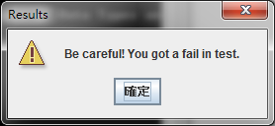
Message Dialog
import javax.swing.JOptionPane;
public class HelloDialogBox {
public static void main( String [ ] args ) {
JOptionPane.showMessageDialog( null, "Welcome\nto\nIVE!" );
}
}
import javax.swing.JOptionPane;
public class TitledMessage {
public static void main( String [ ] args ) {
JOptionPane.showMessageDialog( null,
"Be careful! You got a fail in test.",
"Results",
JOptionPane.WARNING_MESSAGE);
}
}

Slide 15
JOptionPane Icons

Slide 16
Input Dialog
Input dialog returns data in String type.
c:\> java InputDemo
Hello, SM Lau
import javax.swing.JOptionPane;
public class InputDemo {
public static void main( String [ ] args ) {
String name;
name = JOptionPane.showInputDialog(null, "What's your name?");
System.out.println("Hello, " + name);
}
}

Slide 17
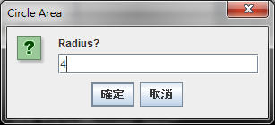
Input Dialog again
import javax.swing.JOptionPane;
public class TitledInputDemo {
public static void main( String [ ] args ) {
String input;
input = JOptionPane.showInputDialog(null,
"Radius?",
"Circle Area",
JOptionPane.QUESTION_MESSAGE);
int radius = Integer.parseInt (input);
double area = radius*radius*Math.PI;
System.out.println("Area=" + area);
}
}
c:\> java InputDemo
Area=50.26548245743669
Convert the String input to integer value before calculation.

Slide 18
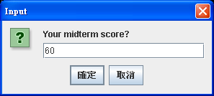
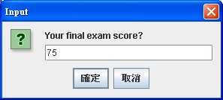
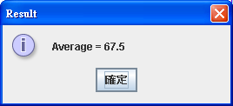
input = JOptionPane.showInputDialog(null,
"Your final exam score?",
"Input",
JOptionPane.QUESTION_MESSAGE);
finalExam = Integer.parseInt(input);
average = (midterm + finalExam) / 2.0;
JOptionPane.showMessageDialog(null,
"Average = " + average,
"Result",
JOptionPane.INFORMATION_MESSAGE);
}
}
import javax.swing.*;
public class GScore
{
public static void main(String [ ] args)
{
int midterm, finalExam;
double average;
String input;
input = JOptionPane.showInputDialog(null,
"Your midterm score?",
"Input",
JOptionPane.QUESTION_MESSAGE);
midterm = Integer.parseInt(input);
Convert the input string to an integer value.

Slide 19
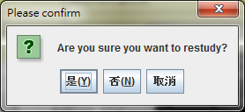
Confirm Dialog
是
c:\> java ConfirmBoxDemo
Your selection is: 0
否
import javax.swing.JOptionPane;
public class ConfirmBoxDemo {
public static void main( String [ ] args ) {
int answer;
answer = JOptionPane.showConfirmDialog(null,
"Are you sure you want to restudy?",
"Please confirm",
JOptionPane.YES_NO_CANCEL_OPTION);
System.out.println("Your selection is: " + answer);
}
}
取消
c:\> java ConfirmBoxDemo
Your selection is: 1
c:\> java ConfirmBoxDemo
Your selection is: 2

Slide 20
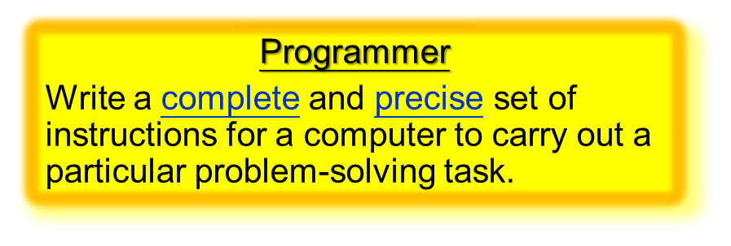
END

